Slide 1
Chapter 6
Business and Organizational Customers and Their Buying Behavior
Notes:
For use only with Perreault/Cannon/McCarthy texts.
© 2019 McGraw-Hill Companies, Inc.
CHAPTER SIX
Lecture Notes for
Essentials of Marketing 16e

Slide 2
At the end of this presentation, you should be able to:
name and give examples of the different types of business and organizational buyers.
describe how organizational and business markets differ from consumer markets.
describe each step in the model of organizational/business buying.
explain the different types of buying processes.
Notes:
At the end of this lecture, you should be able to:
name and give examples of the different types of business and organizational buyers.
describe how organizational and business markets differ from consumer markets.
describe each step in the model of organizational/business buying.
explain the different types of buying processes.

Slide 3
At the end of this presentation, you should be able to:
understand the different types of buyer-seller relationships and their benefits and limitations.
know about the number and distribution of manufacturers and why they are an important customer group.
know how buying by service firms, retailers, wholesalers, and governments is similar to—and different from—buying by manufacturers.
understand important new terms.
Notes:
At the end of this lecture, you should be able to:
understand the different types of buyer-seller relationships and their benefits and limitations.
know about the number and distribution of manufacturers and why they are an important customer group.
know how buying by service firms, retailers, wholesalers, and governments is similar to—and different from—buying by manufacturers.
understand important new terms.

Slide 4
Business and Organizational Customers: A Big Opportunity
Manufacturers
Farms, mines, etc.
Financial institutions
Other providers
Producers
All Business and Organizational Customers
Wholesalers
Retailers
Intermediaries
Federal
State and Local
Government Units
National
Local
Nonprofits
Notes:
Summary Overview
Individual people make purchases to satisfy their needs, but so do organizations. In fact, the organizational market is actually bigger than the final consumer market, at least in terms of the number of purchases made. Thus, it presents significant opportunities for marketers.
Key Issues
The organizational consumer market is often referred to as the industrial market, or the business-to-business (B2B) market.
What type of customers are involved?
Business and organizational customers buy for resale or to produce other goods and services. There are four main categories of these customers:
Producers of goods and services: manufacturers, farmers, real estate developers, etc.
→ Intermediaries: wholesalers and retailers.
→ Government units, at the federal, state, and local levels, as well as foreign governments.
→ Nonprofit organizations, including both national and local organizations.
Discussion Question: What types of products might a manufacturer buy?
→ Indicates place where slide “builds” to include the corresponding point (upon mouse click).

Slide 5
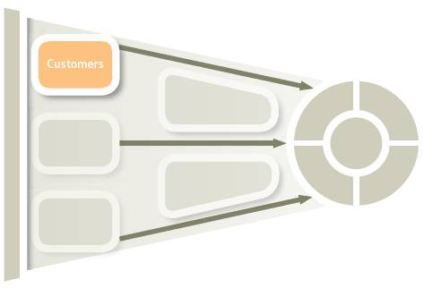
Understanding Business & Organizational Customers for Marketing Strategy Planning (Exhibit 6-1)
Chapter 5
Final Consumers
and Their Buying
Behavior
Chapter 6
Business and Organizational
Customers and Their Buying
Behavior
Business & Organizational
Markets and Customers
Are Different
Fewer/larger buyers
Economic needs
Behavioral needs
Ethical issues
Purchasing managers
Multiple buying influence
Buying procedures
A Model of Organizational/
Business Buying
Defining the problem
Buying process
Managing buyer–seller
relationships
Characteristics of Types
of Organizational
Customers
Manufacturers
Producers of services
Retailers & wholesalers
Government units
Notes:
Summary Overview
Specific aspects of organizational customers are considered in this chapter.
Key Issues
In Chapter 5, we focused on buying by final consumers.
Chapter 6 examines the buying behavior of business and organizational customers.
In this chapter, we explore the important ways that organizational buying tends to be different from buying by final consumers. We look at five factors that define differences between organizational customers and final consumers.
We also examine the key characteristics of four specific types of organizational customers.
Discussion Question: Why might the study of organizational customers be so different from that of final consumers?
→ Indicates place where slide “builds” to include the corresponding point (upon mouse click).

Slide 6

Business and Organizational Customers
Click on play button to view video
Notes:
This clip highlights the many different customers of the Cummins Engine.
Video Operation:
INTERNET CONNECTION REQUIRED
Clicking on the orange circle image will open a web browser and access this video. When the video is completed, you can close or minimize the browser and return to the PowerPoint slides.

Slide 7
Serving International Markets
Click on play button to view video
Notes:
Like the market for individual consumers, internationalization is prevalent in the B2B market. As an example, this ad for FedEx focuses on serving customers in international markets.
Regarding customers in international markets, marketers must understand national and cultural differences.
Video Operation:
INTERNET CONNECTION REQUIRED
Clicking on the orange circle image will open a web browser and access this video. When the video is completed, you can close or minimize the browser and return to the PowerPoint slides.

Slide 8
Differences between Organizational Customers and Final Consumers (Exhibit 6-2)
Multiple buying influence
Fewer but larger
customers
Business &
Organizational
Markets Are
Different
Buyers follow
procedures
Economic needs are
primary
Purchasing
managers are
specialists
Behavioral needs
still matter
Ethical issues arise
Notes:
Summary Overview
Organizational customers and their buying behaviors are different from final consumers and their buying behaviors. These differences play a vital role for marketing strategy planning.
Key Issues
→Fewer in number but larger in dollars purchased. While there are fewer business customers, individually each typically makes much larger purchases than the average consumer. This makes it worthwhile to invest more resources in each customer.
→Economic needs are primary—organizations typically focus on economic factors.
→Behavioral needs still matter. Buyers want security, they want to look good to their colleagues at work, and they usually want to avoid risk.
→Ethical conflicts may arise. Organizational buyers must be careful that their personal interests don’t conflict with company outcomes. For example, some companies have policies that prevent buyers from accepting gifts for fear that the gift might make the buyer less objective when choosing a supplier.
→Purchasing managers are specialists. Today’s purchasing managers are usually well trained professionals that want to solve problems with suppliers.
→Buying procedures are often standardized. To make buying more efficient, many firms have specific procedures that must be followed.
→Many buying centers have multiple people influencing the decision. Although this is not unknown in consumer behavior—we talked about family influences on buying—it is more common in business and organizational buying. It also has a major influence on marketing strategy planning, so let’s take a closer look at multiple buying influence.
→ Indicates place where slide “builds” to include the corresponding point (upon mouse click).

Slide 9

Multiple Buying Influence
Source: BASF Corporation 2015
Notes:
Text Caption: See below.
Summary Overview
Multiple buying influence means that several people—perhaps even top management—play a part in making a purchase decision.
Key Issues
→BASF plastics can be used in automobile parts—replacing heavier metal parts.
The lower weight can increase fuel efficiency.
→BASF personnel work with purchasing managers, production managers, and design engineers at automakers to determine where plastic parts offer the greatest benefit to the end user (car buyer).

Slide 10
Multiple Influence and Roles in the Buying Center
Buyers
Users
Buying
Center
Influencers
Gatekeepers
Deciders
Notes:
Summary Overview
Organizations differ from individual consumers in their buying behavior.
Key Issues
Multiple buying influence
The collection of these influences is a buying center:
→ Buyers: the purchasing managers who are responsible for working with suppliers and arranging for the terms of the sale.
→ Users: the people who will actually use the product—possibly production workers or support staff.
→ Influencers: people whose expertise is used to help determine which products are needed. Influencers are often technical people who help write specifications.
Gatekeepers: people in key positions in the organization who control the flow of information. Gatekeepers include receptionists, secretaries, researchers, and others.
Discussion Question: Why is it important for marketers to establish a good rapport with gatekeepers when selling or marketing to organizations?
Deciders: the people in the organization who have the power to select or approve the supplier.
Marketers must identify and market to every buying center member.
The members of the buying center may change from purchase to purchase.
→ Indicates place where slide “builds” to include the corresponding point (upon mouse click).

Slide 11
Checking Your Knowledge
Consuela Velasquez is a receptionist for a group of seven physicians. As she controls the calendars for the physicians, any sales representatives from a pharmaceutical company wanting to call on the physicians have to go through Consuela. As a result, it is very important for sales reps to cultivate a good relationship with her. In the buying center, Consuela would be best described as a:
A. buyer.
B. user.
C. influencer.
D. gatekeeper.
E. decider.
Notes:
Checking Your Knowledge
Answer: D
Feedback: Consuela is best described as a gatekeeper—a person who controls the flow of information within the organization. The best answer selection is D.

Slide 12
Checking Your Knowledge
Usha Jamison is a purchasing specialist for a large company. She has the authority to execute purchase orders on amounts up to $100,000. On a purchase order for a higher amount, Usha arranges the terms of sale, but the transaction has to be approved by the company president. In the buying center for a purchase in excess of $100,000, Usha is a(n) _________ and the president is a(n)_________.
A. buyer; influencer
B. influencer; buyer
C. buyer; decider
D. gatekeeper; decider
E. user; influencer
Notes:
Checking Your Knowledge
Answer: C
Feedback: The “buyer” is the purchasing manager(s) who has the responsibility for working with suppliers and arranging the terms of the sale. The “decider” is the person in the organization who has the power to select or approve the supplier. In the above question, for purchases in excess of $100,000, Usha would be considered the buyer and the company president would be considered the decider since he/she grants final approval on the sale. The best answer selection is C.

Slide 13
A Model of Organizational Buying (Exhibit 6-4)
Step 1: Defining the problem
Problem recognition
Need description
Product specification
Step 2: Buying process
Establish buying process
Gather information
Solicit bids
Select the supplier
Step 3: Managing the buyer–seller relationship
Structure the relationship
Monitor supplier performance
Notes:
Summary Overview
Organizational buying generally follows the three-step approach shown in Exhibit 6-4.
Key Issues
How each step plays out varies depending on the nature of the purchase.
The third step is not always routinely reviewed.
Let’s take a closer look at these three steps.
→ Indicates place where slide “builds” to include the corresponding point (upon mouse click).

Slide 14
Step 1: Define the Problem
From recognizing problems to describing needs
Specifications describe the product
Notes:
Summary Overview
The basic need of organizations is to satisfy their customers and clients.
Key Issues
From recognizing problems to describing needs.
Problems that crop up in the organization should be narrowed down to specific needs.
Specifications describe the product.
Organizational buyers may buy on the basis of a set of purchasing specifications —a written description of what the firm wants to buy.
Purchase specifications for services are detailed because services are less standardized and are not performed until after they’re purchased.
→ Indicates place where slide “builds” to include the corresponding point (upon mouse click).

Slide 15
Step 2: The Decision-Making Process
Establish buying processes
Gather information
Solicit bids & select suppliers
Notes:
Summary Overview
Step 2 Involves the decision-making process used to make the purchase.
Key Issues
This starts with establishing a buying process, gathering information, and finally soliciting bids (in some cases) and selecting a supplier.
That process results in establishing the buying process for the future.
Let’s take a closer look at this process.
→ Indicates place where slide “builds” to include the corresponding point (upon mouse click).

Slide 16
Organizational Buying Processes
(Exhibit 6-5)
Characteristics
Type of Process
New-Task
Buying
Modified
Rebuy
Straight
Rebuy
Time required
Much
Medium
Little
Multiple influence
Much
Some
Little
Review of suppliers
Much
Some
None
Information needed
Much
Some
Little
Notes:
Summary Overview
Like individual consumers, organizational buyers are problem-solvers. In organizational problem-solving, three kinds of buying processes are useful.
Key Issues
New-task buying occurs when a customer organization has a new need and wants a great deal of information. New-task buying often involves:
setting product specifications;
evaluating sources of supply; and
establishing an order routine to follow in the future.
→ A straight rebuy is a routine repurchase that uses existing suppliers to fill a standard order.
→ A modified rebuy is the in-between process. Some review of the buying process is done but not as much as in a new-task buy.
Discussion Question: If you were selling to an organization, which of the three buying processes would present the easiest opportunity to make a sale? Why? Which buying process would present the greatest challenge? Why?
Straight rebuys often use e-commerce order systems.
New-task buying requires information.
→ Indicates place where slide “builds” to include the corresponding point (upon mouse click).

Slide 17
Major Sources of Information Used by Organizational Buyers (Exhibit 6-6)
Marketing sources
Nonmarketing sources
Salespeople
Others from supplier firms
Trade shows
Buying center members
Outside business associates
Consultants and outside experts
Personal Sources
Online events and virtual trade shows
Sales literature and catalogs
Emails and newsletters
Website content (blogs, videos, case studies, and white papers)
Social media
Online searches
Rating services
Trade associations
News publications
Product directories
Online communities
Social media
Impersonal
Sources
Notes:
Summary Overview
A new-task buy starts with a user who becomes aware of a need and begins researching solutions. This exhibit lists the sources available for the business buyers.
Even though a wide variety of information sources are available, business buyers will use the sources they trust. To build trust, a marketer must make sure its information is reliable.
Key Issues
One source of information comes from the marketing firm. This includes personal information that comes from talking to the selling firm’s personnel.
In addition, the firm produces information that appears in print form on paper or online.
Buyers will also turn to sources of information outside the direct control of the seller. These can be personal sources or…
Impersonal sources.
→ Indicates place where slide “builds” to include the corresponding point (upon mouse click).

Slide 18
New-Task Buying Requires Information
Websites
Search Engines
New-Task
Buying
Requires
Information
Online Communities
Competitive Bids
Notes:
Summary Overview
New-task buying situations provide a good opportunity for a new supplier to make inroads with a customer.
Key Issues
→ Search engines: a first step to gather information.
→ Buyers want sites with useful content.
→ Buyers share experiences in online communities.
→ Buyers ask for competitive bids to compare offerings:
After buyers in B2B markets identify potential suppliers, they might ask them to submit a competitive bid—the terms of sale offered by the supplier in response to the purchase specifications posted by a buyer.
→ Buyers make important decisions about how to deal with one or more suppliers.
→ A buyer might want to rely on competition among all available vendors to get the best price on each and every order it places.
Many firms use vendor analysis—a formal rating of suppliers on all relevant areas of performance.
The goal is to lower the total costs associated with purchases.
→ A buyer might just routinely buy from one vendor with whom it already has a good relationship.
→ Indicates place where slide “builds” to include the corresponding point (upon mouse click).

Slide 19
Checking Your Knowledge
Nolan Jackson, a sales representative for an industrial supply house, calls on a prospective business customer. The customer has an established relationship with another supplier but says that there have been some reliability problems with deliveries. Nolan seizes the opportunity to describe his company’s state-of-the-art logistics and transportation system that provides outstanding delivery reliability at low shipping costs. Nolan is encouraged because his customer seems to be in a ___________ situation.
A. straight rebuy
B. modified rebuy
C. new-task
D. extensive problem-solving
E. limited problem-solving
Notes:
Checking Your Knowledge
Answer: B
Feedback: In the above question, Nolan’s customer appears to be in a modified rebuy situation. A modified rebuy is in-between a new-task buying and a straight rebuy. It is a process where some review of the buying situation is done—though not as much as in new-task buying. This modified rebuy situation appears to be an opportunity for Nolan. Although the customer has been purchasing from another supplier, the buyer is now receptive to information from Nolan. The best answer selection is B.

Slide 20
Checking Your Knowledge
Auto parts wholesaler Fixem, Inc. decides to invest in a new data management system to increase the efficiency of its warehouse operations. Previously, all record-keeping was done via printed documents, but now all transactions will be electronic. This change will require Fixem to expend a significant amount of money for hardware, software, and training. However, in the long run, the cost savings should exceed the up-front investment. Fixem has arranged for presentations to be made by three different vendors. Fixem seems to be facing a ______________ buying situation.
A. straight rebuy
B. modified rebuy
C. new-task
D. extensive problem-solving
E. limited problem-solving
Notes:
Checking your knowledge
Answer: C
Feedback: New-task buying occurs when an organization has a new need and the customer wants a great deal of information. In the above question, Fixem is investing in a new data management system (a new need) and they want to hear presentations from three different vendors. Fixem appears to be facing a new-task buying situation. The best answer selection is C.

Slide 21
Step 3: Managing Buyer-Seller Relationships in Business Markets
Close Relationships
May Produce
Mutual Benefits
Relationships May Not Make Sense
Relationships
can involve
many from
both sides
Reduced flexibility
Some purchases are too small or infrequent
Some purchases require much special attention
Mutual trust
Long-term outlook
Share tasks at lower total cost
Notes:
Summary Overview
Relationships between buyers and sellers in the B2B market may be casual, “arm’s length” relationships, or they can be close, long-lasting partnerships. Marketers should know the degree of closeness that is appropriate for a given relationship.
Key Issues
→ Close relationships between buyers and sellers may produce mutual benefits.
The best relationships involve real partnerships where there’s mutual trust and a long-term outlook.
Closely tied firms often share tasks at lower total cost than would be possible working at arm’s length.
Discussion Question: What factors would contribute to the development of a close partnership between a buyer and seller in the B2B market?
Relationships can involve many from both sides.
To develop effective solutions, those closest to the problems should be directly involved.
→ Close relationships may not make sense.
They can reduce a buyer’s flexibility and leverage.
Some purchases are simply too small or too infrequent.
Some purchases require so much special attention that the relationship would never be profitable for the seller.
→ Indicates place where slide “builds” to include the corresponding point (upon mouse click).

Slide 22

Relationships may not make sense
Courtesy of Kaleidoscope
Notes:
Text Caption: See below.
Summary Overview
In today's business markets, many suppliers of goods and services seek to build long-term relationships that provide value for their customers. Kaleidoscope provides services to help its customers with brand strategy and design. In this ad, Kaleidescope says “‘Bite-sized’ relationships are a dime a dozen. But there is nothing sweeter than working with people you like who deliver consistent results year after year… .”

Slide 23
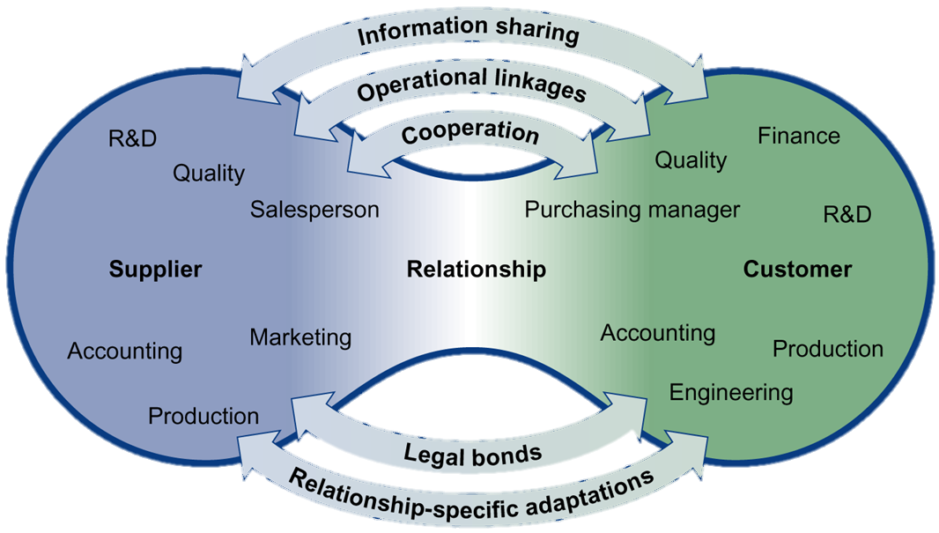
Relationships Have Many Dimensions (Exhibit 6-7)
Notes:
Summary Overview
There are several key dimensions that characterize a close working relationship between organizational buyers and sellers.
Key Issues
Problems are joint responsibilities when buyers and sellers cooperate.
The buyer and seller work together to achieve both mutual and individual objectives.
Both sides are involved in problem resolution.
Both the supplier and the buyer benefit when they can share information. Types of shared information may include:
the exchange of proprietary cost data, discussion of demand forecasts, and joint work on new product designs;
updated information;
less duplication of basic information (saves time); and
reduced uncertainty about the future and better planning, which leads to better decisions.
Even though shared information is useful, it may be risky if there is a possibility that one of the partners will misuse it.
Discussion Question: If you represented an organizational buyer, what types of information might you be reluctant to share with a supplier? If you represented a supplier, what types of information might you be reluctant to share with a buyer?
Aside from cooperation and information sharing, there are other key dimensions of close buyer–seller relationships in the B2B market.
Key Issues
Operational linkages are direct ties between the internal operations of the buyer and seller firms. These linkages usually involve ongoing coordination of activities between the firms.
Just-in-time delivery: reliably getting products there just before the customer needs them.
This arrangement reduces inventory and carrying costs, especially for the buyer.
Discussion Question: Walmart, a major retailer, has a direct computer connection to Procter & Gamble, a manufacturer, to speed up order and delivery of P&G’s products. How does this move the relationship toward a straight rebuy situation?
Legal bonds, such as contracts, spell out the obligations of each party in the relationship.
Negotiated contract buying: agreeing to a contract that allows for changes in the purchase arrangements.
This method is preferred when it is difficult or impossible to specify all that is needed on a particular project in advance.
Relationship-specific adaptations invest in the relationship.
These adaptations involve changes in a firm’s product or procedures that are unique to the needs or capabilities of a relationship partner.
Specific adaptations are usually made when the buying organization chooses to outsource—contract with an outside firm to produce goods or services rather than to produce them internally.

Slide 24
Relationship Dimensions
Click on play button to view video
Notes:
Cargill “Florence” commercial: Close buyer–seller relationships can help both buyers and sellers. In this advertising campaign, Cargill wants to communicate to its customers that by working closely with them it is helping them to succeed.
Discussion Question: Which relationship dimensions do you think Cargill is emphasizing in this commercial?
Video Operation:
INTERNET CONNECTION REQUIRED
Clicking on the orange circle image will open a web browser and access this video. When the video is completed, you can close or minimize the browser and return to the PowerPoint slides.

Slide 25
Relationship Dimensions
Click on play button to view video
Notes:
Cargill “Chocolate” commercial: Close buyer–seller relationships can help both buyers and sellers. In this advertising campaign, Cargill wants to communicate to customers that by working closely with them it is helping them to succeed.
Discussion Question: How does Cargill create value for its customers?
Video Operation:
INTERNET CONNECTION REQUIRED
Clicking on the orange circle image will open a web browser and access this video. When the video is completed, you can close or minimize the browser and return to the PowerPoint slides.

Slide 26
Checking Your Knowledge
Gotcha! is a chain of trendy stores catering to the urban contemporary market. As part of its close relationship with suppliers, Gotcha! has an Internet site that is accessible only by suppliers, and it provides up-to-the minute point-of-sale information from all of the Gotcha! stores. Suppliers can see how their products are doing at retail during any time of the day or night. In the relationship between Gotcha! and its suppliers, the Gotcha! supplier site is an example of:
A. information sharing.
B. legal bonds.
C. reciprocity.
D. operational linkages.
E. negotiated contracts.
Notes:
Checking Your Knowledge
Answer: A
Feedback: Some relationships involve open sharing of information. This might include exchanges of proprietary cost data, discussion of demand forecasts, etc. The relationship between Gotcha! and its suppliers is one in which information is shared via the Gotcha! site. The best answer selection for this question is A.

Slide 27
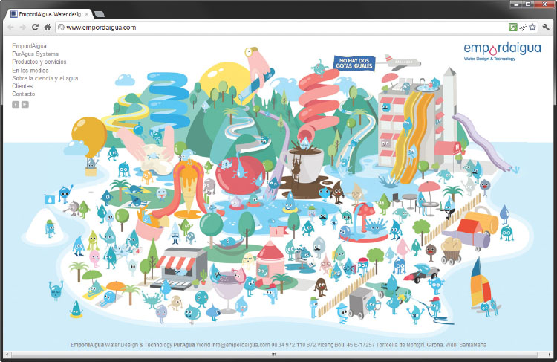
Buyer–Seller Relationships
Source: EmpordAigUA® Water Design & Technology.
Notes:
Text Caption: See below.
Summary Overview
Relationship-specific adaptations involve changes in a firm’s product or procedures that are unique to the needs or capabilities of a relationship partner.
Key Issues
Spain's EmpordAigua offers consulting services to help firms manage water quality and usage.
EmpordAigua believes that no two drops of water are alike—nor are any two customers’ water needs.
EmpordAigua develops close buyer–seller relationships based on:
cooperation;
information sharing;
relationship-specific adaptations.
This approach is undertaken to develop custom water solutions for each of its client’s needs.

Slide 28

Dynamics of Buyer–Seller Relationships
Powerful Customer May Control the Relationship
Buyers May Use Several Sources to Spread Risks
©Shutterstock / bluedog studio
Buying Varies by Customer Type
Notes:
Summary Overview
In addition to the five main dimensions of buyer–seller relationships in the B2B market, there are other dynamics that can affect the overall relationship.
Key Issues
→ There may be an imbalance of power favoring one of the partners—a powerful customer may control the relationship.
Although a marketing manager may want to work in a cooperative partnership, that may be impossible with large customers who have the power to dictate how the relationship will work.
→ Buyers may still use several sources to reduce their risk.
Buyers often look for several dependable sources of supply to protect themselves from unpredictable events.
→ There are variations in buying by customer type.
→ Indicates place where slide “builds” to include the corresponding point (upon mouse click).

Slide 29

Manufacturers Are Important Customers
Not Many Big Ones
Clustered in Geographic Areas
Business Data Classifies Industries
NAICS Codes
©Shutterstock / Fransen
Notes:
Summary Overview
Manufacturers are important organizational buyers because a relatively small number account for a large proportion of organizational buying.
Key Issues
In the United States and in other countries, there are relatively few manufacturers compared to the number of final consumers.
→ There are not many big ones.
In the United States, over half of the manufacturers have fewer than 10 workers.
Discussion Question: Why would it make sense for marketers to segment manufacturing consumers by size?
→ Customers cluster in geographic areas.
In the United States, manufacturers are concentrated in the big metropolitan areas—especially in New York, Pennsylvania, Ohio, Illinois, Texas, and California.
There is concentration by industry too.
→ Business data often classifies industries.
The products an industrial customer needs to buy depend on the business it is in.
Because of this, sales of a product are often concentrated among customers in similar businesses.
Marketing managers must focus their marketing mixes on prospective customers who exhibit characteristics similar to their current customers.
North American Industry Classification System (NAICS) codes: groups of firms in similar lines of business.
→ Indicates place where slide “builds” to include the corresponding point (upon mouse click).

Slide 30
Illustrative NAICS Code Breakdown for Apparel Manufacturers (Exhibit 6-8)
Construction (23)
Manufacturing (31)
Retail
(44)
others…
Food (311)
Apparel (315)
Leather (316)
others…
Knitting Mills (3151)
Cut & Sew Apparel (3152)
Apparel accessories (3159)
others…
Men’s & boys’ (31522)
Women’s & girls’ (31523)
Other cut & sew (31529)
others…
Lingerie (315231)
Blouses (315232)
Dresses (315233)
others…
Notes:
Summary Overview
This exhibit contains an example of how the NAICS codes apply to the apparel industry.
Key Issues
The broadest category is the general industry category. Manufacturing, for example, has a two-digit NAICS code of 31.
→ Adding a digit to the manufacturing code narrows the industry definition to apparel—code 315.
→ The industry definition gets narrower if another digit is added to the code—in this case, cut and sew apparel, code 3152.
→ Adding still another digit reduces the category to women’s and girls’ cut and sew apparel—NAICS code 31523.
→ Finally, a sixth digit narrows the industry definition to blouses, NAICS code 315232.
Knowing the appropriate NAICS code for an industry opens the door to a wide range of government and privately compiled sources of information, such as lists of companies, trade publication articles, and industry-wide statistics.
→ Indicates place where slide “builds” to include the corresponding point (upon mouse click).

Slide 31






Producers of Services — Smaller and More Spread Out
Car Repair
Medical Services
Legal Services
©Shutterstock / Minerva Studio; Shutterstock / wavebreakmedia; © Hero Images/AGE Fotostock; avid_creative/Getty Images; asiseeit/Getty Images; Image Source/Phil Boorman
Housekeeping
Services
Library
Service
Small Service
Buyers
Buying May Not Be Formal
Notes:
Summary Overview
Service producers are more geographically dispersed than are manufacturers. In the United States, this segment of the economy is large and growing fast.
Key Issues
There are about 4.6 million service firms in the United States.
Some of these firms have names that are widely recognized.
Many of the service providers are quite small.
These service firms are also dispersed over a wide geographic area.
→ Because of their small size, many service firms have buying procedures that may not be as formal as in larger organizations.
Many of these buyers need more help in making their purchases than do the purchasing managers in a large company.
Small service customers like Internet buying.
Discussion Question: What types of products or services might be purchased by the types of service providers illustrated on this slide?
→ Indicates place where slide “builds” to include the corresponding point (upon mouse click).

Slide 32

Retailers and Wholesalers Buy for Their Customers
Committee Buying Is Impersonal
Reorders Are Straight Rebuys
Buyers Watch Computer Output Closely
©Shutterstock / hxdbzxy
Notes:
Summary Overview
Retailers and wholesalers see themselves as purchasing agents for their target customers. Retailers buy what they think they can profitably sell to final consumers.
Key Issues
Committee buying assigns the buying decision to a committee that reviews reports submitted by the buyer.
Committee buying is impersonal.
→ Computers track inventory, sales, and prices. Buyers watch this computer output closely.
→ Many reorder decisions are made automatically via computer links to suppliers.
Reorders are straight rebuys.
Discussion Question: What types of valuable information could a salesperson give a buyer?
→ Indicates place where slide “builds” to include the corresponding point (upon mouse click).

Slide 33
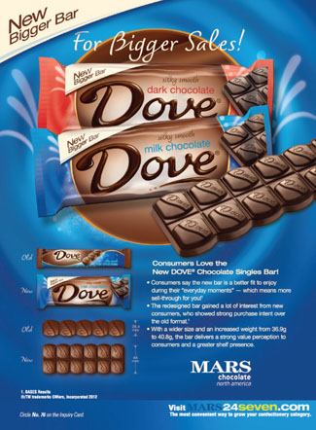
Reorders are straight rebuys
Source: Mars, Incorporated
Notes:
Text Caption: See below.
Summary Overview
Retailers see themselves as buying agents for their target customers—but they also have to determine what they can profitably sell. Retailers are attracted to well-known brands such as Dove because they know their consumers are more likely to buy brands they know.

Slide 34

The Government Market
Size and Diversity
FCPA
Competitive Bids
Foreign Governments
“Approved” Supplier List
Government Wants
© Shutterstock / Gang Liu
Notes:
Summary Overview
Government buyers typically use competitive bidding and approved supplier lists and put legal constraints on the latitude of individual buyers.
Key Issues
→ The size and diversity of the government market make it an attractive target.
→ Government buyers are restrained by purchasing regulations, and competitive bids may be required.
Discussion Question: What is the objective in requiring competitive bids and exacting specifications?
→ For routine purchases, a government unit can prepare an approved supplier list.
→ Government publications help marketers to learn what government wants to buy.
→ In dealing with foreign governments, information is less available, and there may be significant obstacles that favor a domestic supplier.
→ Is it unethical to buy help in dealing with foreign governments?
Not in some countries.
→ In the United States, the Foreign Corrupt Practices Act (FCPA) prohibits U.S. firms from paying bribes to foreign officials.
→ Indicates place where slide “builds” to include the corresponding point (upon mouse click).

Slide 35
Key Terms
business and organizational customers
purchasing managers
multiple buying influence
buying center
requisition
purchasing specifications
new task buying
straight rebuy
modified rebuy
white paper
competitive bid
vendor analysis
just-in-time delivery
negotiated contract buying
outsource
North American Industry Classification System (NAICS) codes
Foreign Corrupt Practices Act
Notes:
Summary Overview
These are key terms you should be familiar with based upon the material in this presentation.
Key Issues
Business and organizational customers: any buyers who buy for resale or to produce other goods and services.
Purchasing managers: buying specialists for their employers.
Multiple buying influence: several people share in making a purchase decision--perhaps even top management.
Buying center: all the people who participate in or influence a purchase.
Requisition: a request to buy something.
Purchasing specifications: a written or electronic description of what a firm wants to buy.
New-task buying: when an organization has a new need and the buyer wants a great deal of information.
Straight rebuy: a routine repurchase that may have been made many times before.
White paper: An authoritative report or guide that addresses important issues in an industry and offers solutions.
Modified rebuy: the in-between process where some review of the buying situation is done — though not as much as in new-task buying or as little as in straight rebuys.
Competitive bid: terms of sale offered by different suppliers in response to the buyer's purchase specifications.
Vendor analysis: formal rating of suppliers on all relevant areas of performance.
Just-in-time delivery: reliably getting products there just before the customer needs them.
Negotiated contract buying: agreeing to a contract that allows for changes in the purchase arrangements.
Outsource: contract with an outside firm to produce goods or services rather than to produce them internally.
North American Industry Classification System (NAICS) codes: codes used to identify groups of firms in similar lines of business.
Foreign Corrupt Practices Act: a law passed by the U.S. Congress in 1977 that prohibits U.S. firms from paying bribes to foreign officials.
This slide refers to boldfaced terms appearing in Chapter 6.

